Slide 1
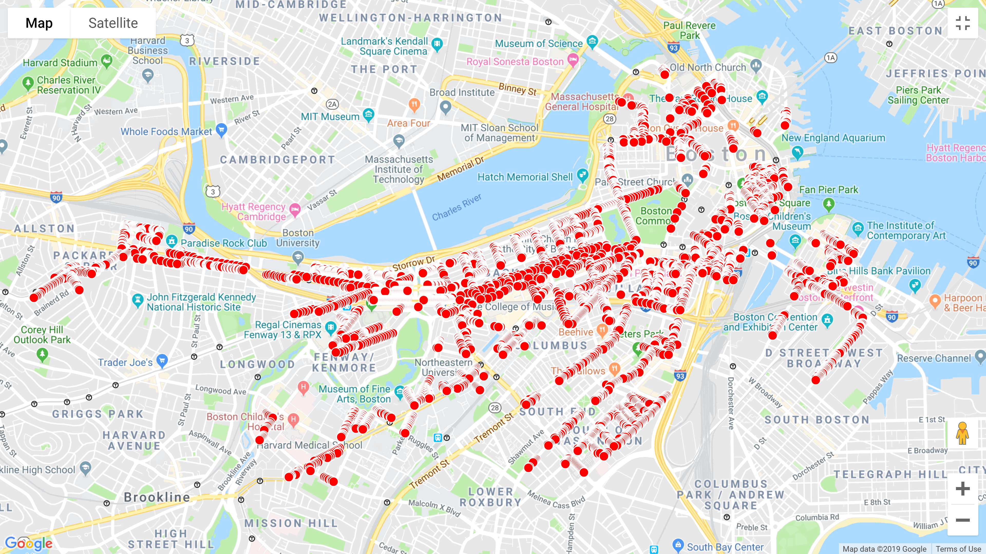


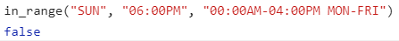
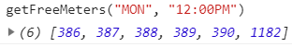
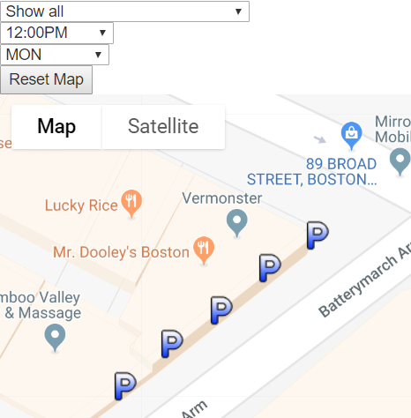
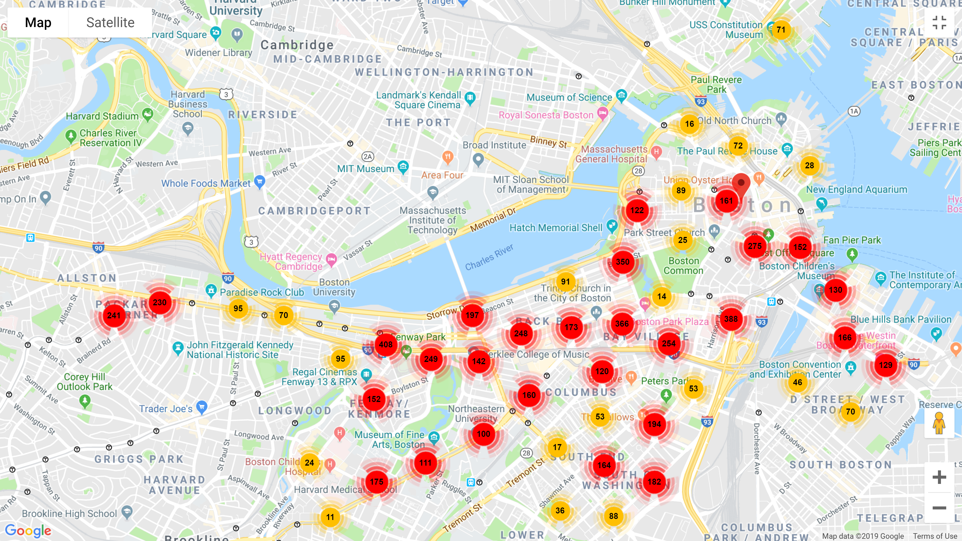
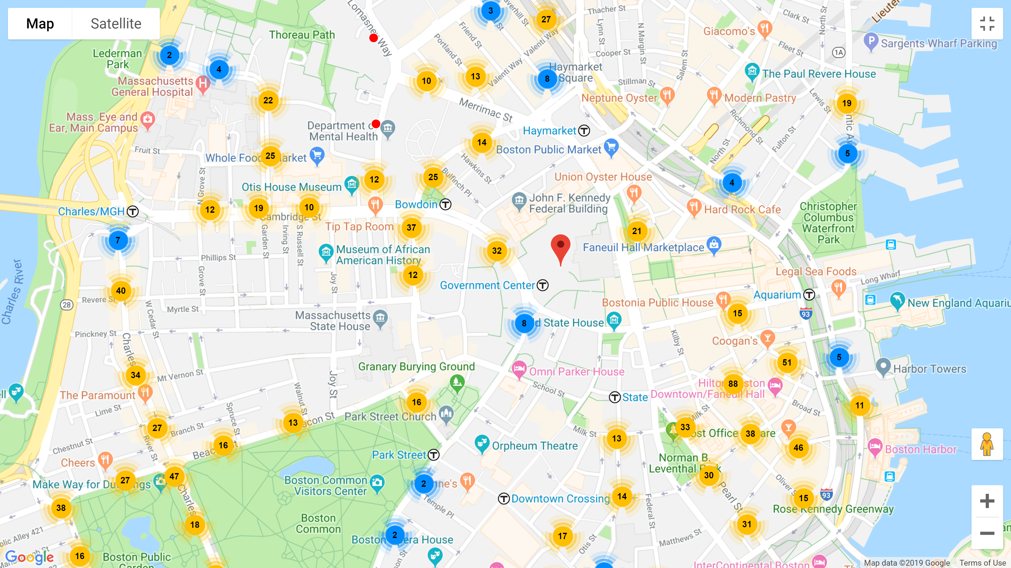
Boston, Big Data, and Web Technologies
Organizing Data
With a large database of 6955 parking meters in the city of Boston, grouping and filtering meters by certain properties makes data digestible and patterns noticeable by filtering meters by the most relevant of 41 properties. Entries with missing information are discarded.
ABSTRACT
EXTRACT DATA
Parsing Data
INTERACTIVE MAP
Free parking times in the database are given as 19-23 character length strings, which isn’t an naturally useful form for data extraction. A parsing function extracts start and end times and days and performs a series of string comparisons to provide the user with a list of all free parking meters on a given day and time.
Big Data Problems
Initial plotting of all 7000 parking spaces created tremendous lagging of nearly 7 seconds for each movement. The overlapping markers interfered with users’ processing of the actual number of available parking in any particular region.
EXPLAIN DATA
User Interface
The website allows the user to select from 189 streets, 24 hours, and 7 days to see free parking meters on the selected day and time, and near a certain street if selected. Once these fields are selected,

